Slide 1




FAST MRI: DYAMOND
Breast Cancer CAG Conference - 14th March 2025
Dr Rebecca Geach
Consultant Radiologist/Co-Lead DYAMOND
Dr Lyn Jones
Honorary Consultant Radiologist/CI Dyamond
North Bristol NHS Trust
Notes:
Good morning and thank you for the opportunity to present the DYAMOND study today. My name is Rebecca Geach, I am a consultant radiologist in North Bristol, and I am Co-lead in the study working alongside Dr Lyn Jones who is an honorary consultant radiologist and the CI on the study.
As an introduction, the DYAMOND study is an important step in the FAST MRI programme of research at North Bristol Trust, which is looking at FAST MRI’s potential, as a screening test, to improve breast cancer outcomes for women.

Slide 2
Funding reference: NIHR 150502
Trial registration: ISRCTN 74193022
DISCLOSURE
No other relevant financial relationships exist
Dr Rebecca Geach
Consultant Radiologist/Co-Lead DYAMOND
Dr Lyn Jones
Honorary Consultant Radiologist/CI Dyamond
North Bristol NHS Trust
Notes:
This is our disclosure slide. DYAMOND is grant-funded jointly by the Medical Research Council and the NIHR through their Efficacy and Mechanism Evaluation funding stream
There are no other financial relationships to disclose.

Slide 3

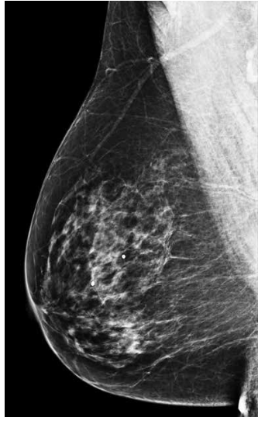
B
FAST MRI Diagnostic Yield study for Average MammOgraphic screeNing Density
Aim: To see if FAST MRI can detect breast cancers that have been missed by mammography for women with average breast density (BI-RADS classification B) at their first screening mammogram (age 50-52)
~40%
Notes:
“DYAMOND” is a diagnostic yield study that will determine the number of cancers detected by FAST MRI that have been missed by screening mammography for women with average breast density, BI-RADS category B. Approx 40% women aged 50-52 will have their mammographic density recorded as BIRADS B.
The study population is women having their first screening mammogram at age 50-52, the prevalent round.
We chose this population because, as the youngest women in the population-risk screening programme, they are less likely to suffer from overdiagnosis than older women.
In terms of breast density, it is a scale from A to to D
But why did we choose the BI-RADS Bs – average mammographic density?

Slide 4
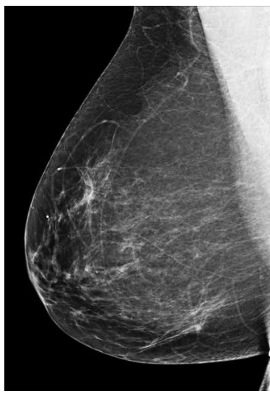
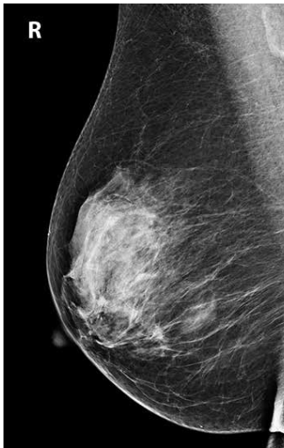
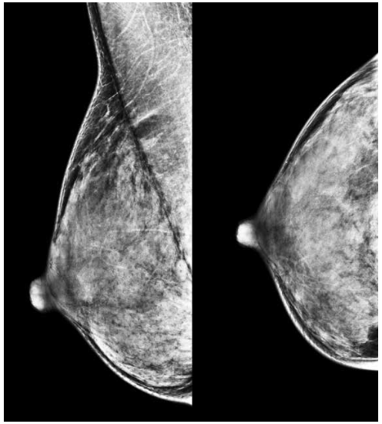
Mammographic Density
BI-RADS Atlas 2013
A
B
C
D
10%
40%
40%
10%
A – almost all fatty
B – scattered density
C – heterogeneously dense
D – extremely dense
Notes:
BIRADS density scale from A to D, a are almost fatty breasts and D are extremely dense. Our population women with average density, so BIRADS B and approximately 40% women aged 50-52 will be in this category.
So why have we chosen Birads B….

Slide 5
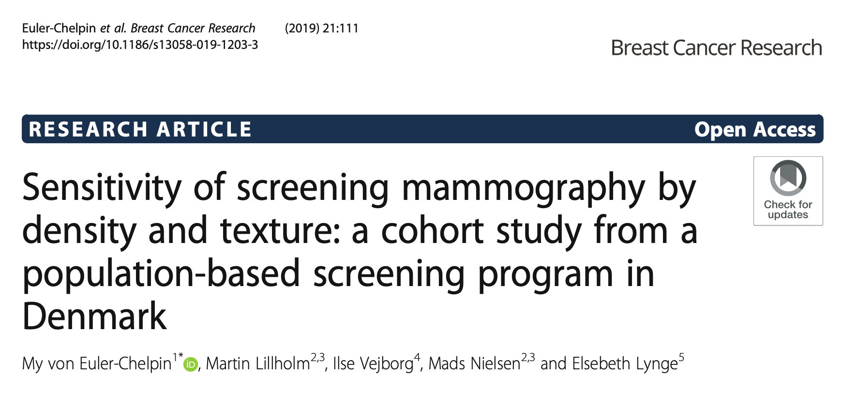
Mammography missed:
50% cancers in the densest breasts
20% cancers in the least dense breasts
Mammography’s
Performance by Density
Notes:
Research often focuses on breast cancers missed by mammography in women with the most dense breasts.
Women with BI-RADS density B have their cancers missed by mammography too.
This Danish screening study found that mammography missed over 50% of cancers for women in the densest mammographic category but it also missed 20% of cancers for women in the least dense category.

Slide 6
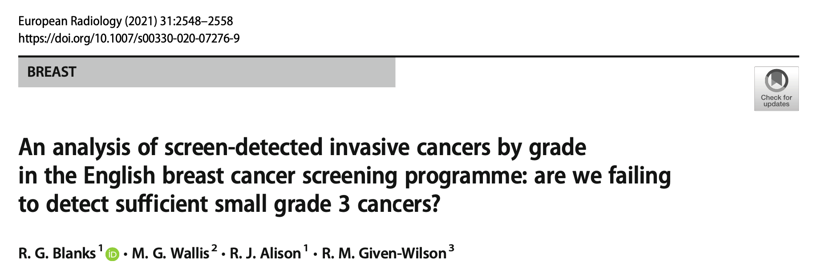
The relative sensitivity mammography small grade 3 cancers was 26% of that for grade 1 cancers
Some cancers are more important to detect early than others
Notes:
And in terms of the biology of cancers that were missed…
The most difficult cancers for mammography to detect are the small aggressive cancers, the cancers that could make the greatest difference to a woman’s survival if we could find them earlier
This paper estimated that the relative sensitivity of mammographic screening for small (<15mm) grade 3 cancers is only a quarter of that for small grade 1 cancers…
So, there is considerable potential for more lives to be saved from breast cancer through earlier detection.

Slide 7
Mammographic Screening in the UK
Net survival after breast cancer diagnosis (CRUK)
  1 year ~95%
  5 years ~ 85%
  10 years ~ 75%
45% women diagnosed with breast cancer eventually die from breast cancer (Lawrence et al. 2013 “Back to basics” Breast cancer incidence and mortality)
>57,000 people are living with metastatic breast cancer (Palmieri 2022 JAMA Network Open)
Underdiagnosis effects: delayed diagnosis, delayed treatment, a higher morbidity (living with metastatic breast cancer/treatments) and of breast cancer mortality
Notes:
Compared with other cancers, breast cancer has high 1, 5 and 10-year net survival rates,… still, 45% of women diagnosed with breast cancer in the UK do eventually die from breast cancer and it has been estimated that over 57,000 people in the UK are living with metastatic breast cancer and that means living with the knowledge that their cancer is incurable.
Mammographic underdiagnosis of small aggressive cancers causes treatment delay and an increased chance both of the morbidity of living with metastatic breast cancer and with its treatment, and ultimately a higher chance of breast cancer mortality.
If earlier detection with MRI could find breast cancers earlier before they metastasize, could the higher cost of screening with MRI potentially be offset by lower metastatic treatment costs?

Slide 8
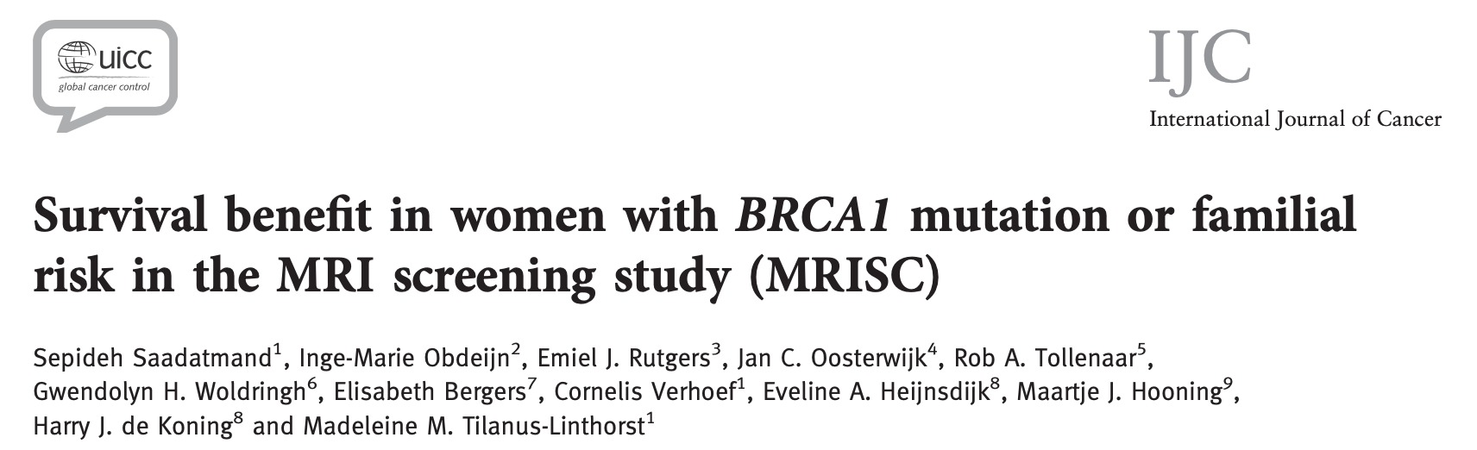

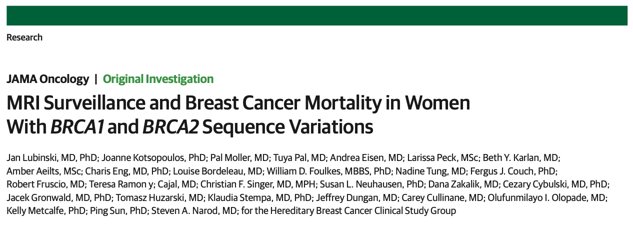
Breast MRI - benefits
Smaller primary tumours
Fewer node positive
Less chemotherapy
↑ metastasis-free survival
JAMA Oncol. doi:10.1001/jamaoncol.2023.6944 Published online February 2024
Notes:
We know, from these studies, that MRI can pick up sub-centimetre aggressive breast cancer and provide a survival advantage for women at very high risk.
Could we use MRI to achieve earlier detection and to improve survival from breast cancer for a wider group of women and not restrict its use to only those at very high risk?

Slide 9
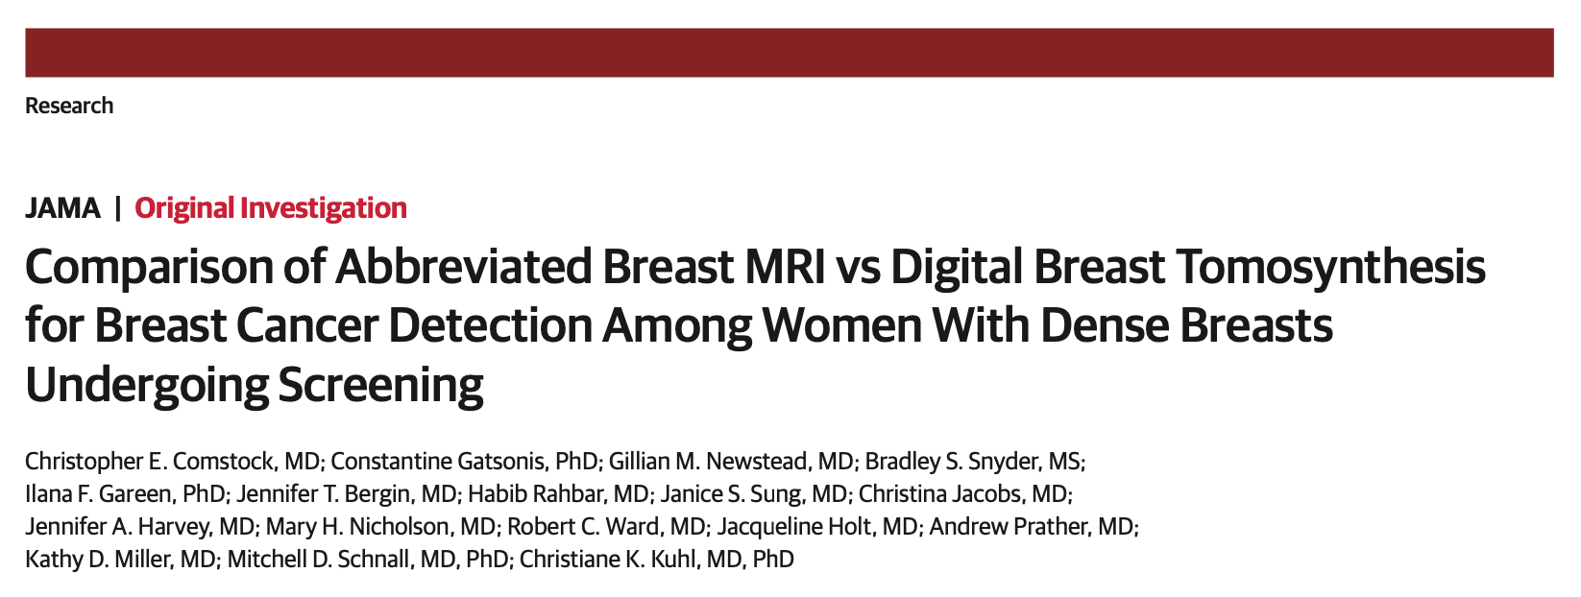
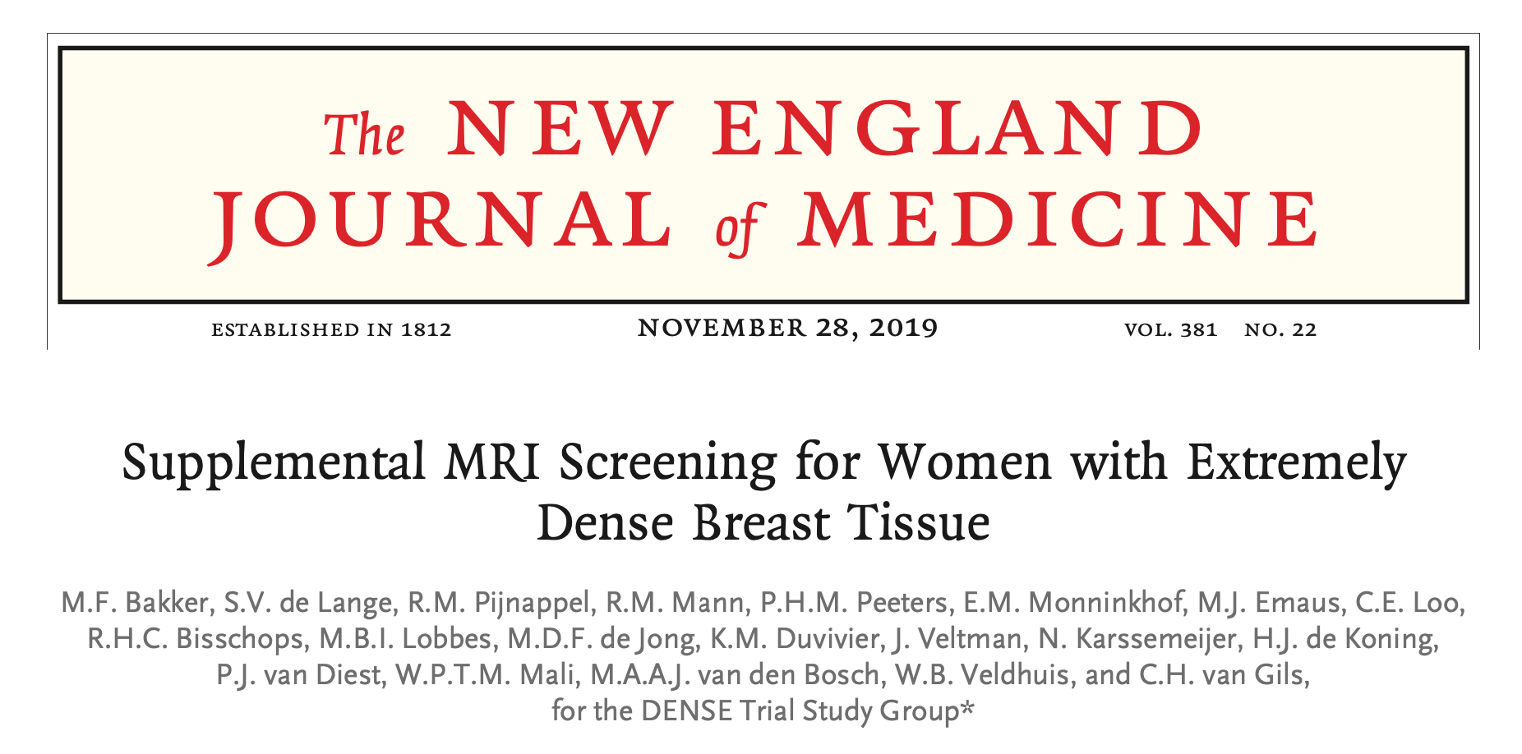
Abbreviated breast MRI AbMRI detected 17/17 cancers
DBT detected 7/17 cancers
C
D
D
D
Full protocol breast MRI
Additional 16.5 cancers/1000 detected and
Interval cancers reduced from 5/1000 to 0.8/1000
Notes:
Until now, researchers have understandably focused on women with heterogeneously dense or extremely dense breasts.
Christopher Comstock’s EA1141 trial has shown an impressive additional cancer detection by abbreviated MRI over digital breast tomosynthesis, and the DENSE trial additionally showed a five-fold reduction in the interval cancer rate over mammographic techniques,… demonstrating that the additional cancers found were clinically significant.

Slide 10

UK Research
D
D
The BRAID Trial
Supplemental screening
NHSBSP screening clients aged 50-70
Automated breast ultrasound
Contrast-enhanced spectral mammography
Abbreviated breast MRI
No supplemental screening
Primary outcome: Cancer detection rate
C
D
Notes:
In the UK, Fiona Gilbert’s BRAID Trial is also looking at women with BI-RADS C and D breasts. BRAID is additionally comparing 3 different supplemental screening modalities, including abbreviated MRI, and is also measuring participants’ polygenic risk for breast cancer to predict cancer risk.

Slide 11
Mammographic Density
BI-RADS Atlas 2013
A
B
C
D
10%
40%
40%
10%
A – almost all fatty
B – scattered density
C – heterogeneously dense
D – extremely dense
Notes:
DYAMOND was designed to complement the BRAID Trial and to discover whether FAST MRI can detect sufficient cancers missed by mammography for women with category B breasts to justify their inclusion in a screening trial of FAST MRI.
If sufficient cancers are detected by FAST MRI in DYAMOND, the implication is that FAST MRI could need to be provided at scale, since at age 50-52, 90% of the female population has BI-RADS category B, C or D. DYAMOND’s design was therefore mindful to keep costs of FAST MRI delivery as low as possible.

Slide 12
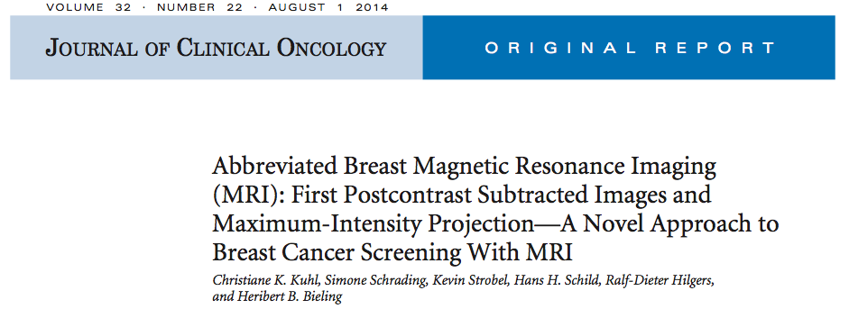
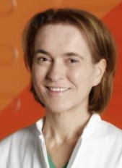
What is FAST MRI ?
Notes:
FAST MRI is a short form of breast MRI. It was designed to be cheaper and faster than standard breast MRI so that it could provide cost effective screening for breast cancer with the sensitivity for aggressive cancers of full protocol breast MRI but with times to acquire and to interpret more comparable with that of a mammogram.
In this proof-of-concept paper, it was presented as needing just 3 minutes for the woman to lie on the MRI scanner and about 30 seconds for expert MRI readers to interpret.

Slide 13
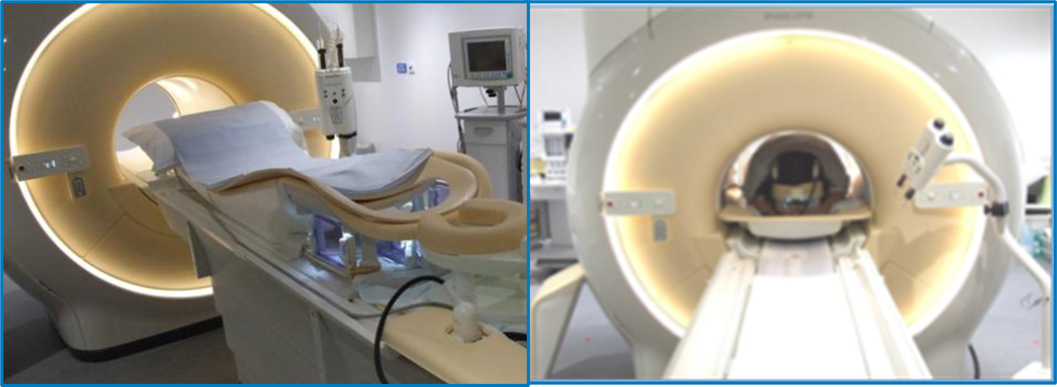
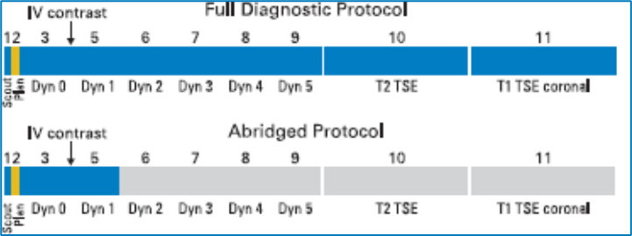
What is a FAST MRI ?
Protocol diagram from Kuhl JCO 2014
Notes:
Schematic here, published by C Kuhl a German radiologist in her proof of concept study in 2014.

Slide 14
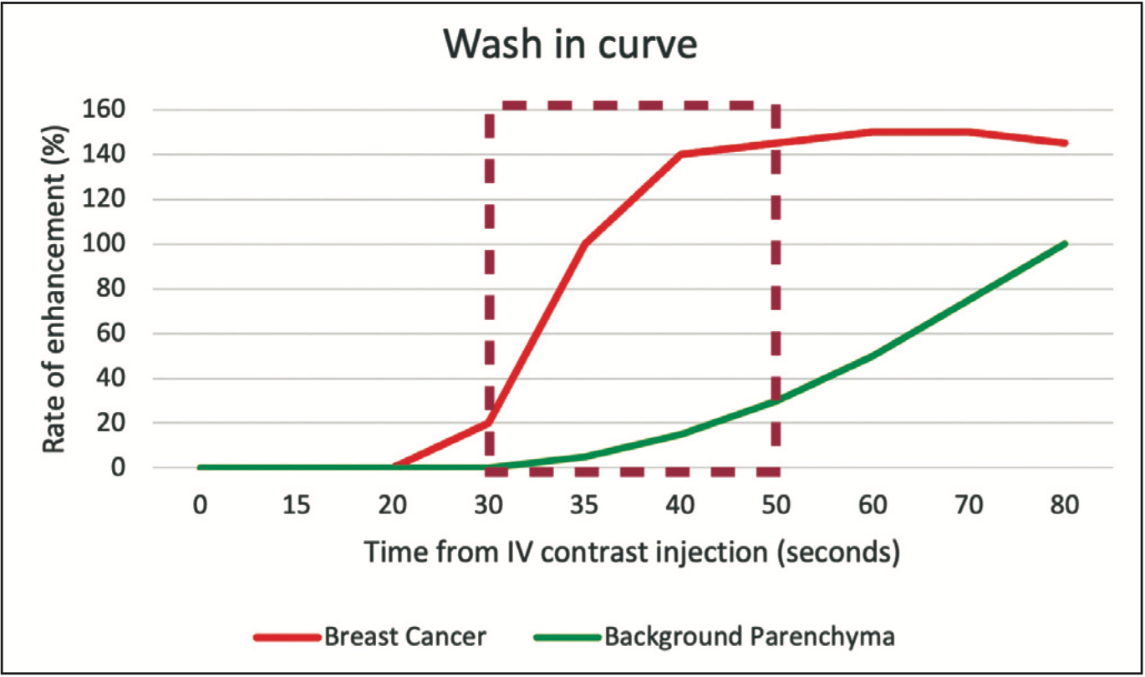
Why First Post Contrast Subtracted Images?
Notes:
Why do we choose the first post contrast images:
The concept is that aggressive breast cancers enhance early after the injection of contrast, benign breast lesions and normal glandular breast tissue enhance later, therefore have this small window of opportunity after the injection of contrast where you can visulaise the breast cancers and subtract out benign/normal glandular breast tissue.

Slide 15
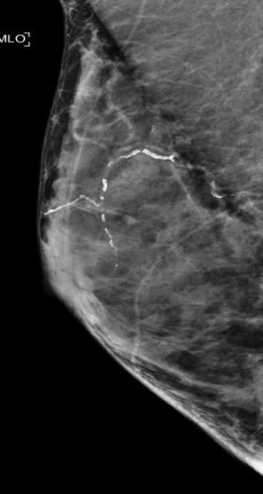
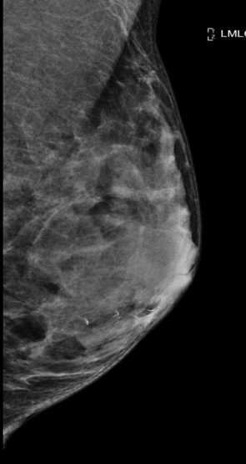
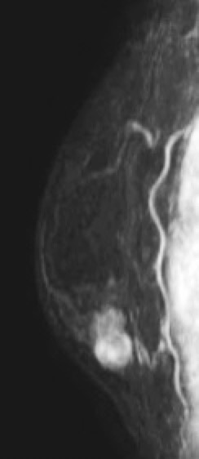
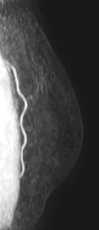
Mammograms
FAST MRI
Aggressive, high-grade cancers are not always visible on mammograms,
leading to underdiagnosis in mammographic screening programmes
Notes:
This slide compares the mammograms, on the left, with the equivalent FAST MRI images, on the right, for a woman presenting symptomatically with a grade 3 triple negative breast cancer that is occult or invisible on her mammograms but lights up like a beacon on the FAST MRI images of her breast MRI scan.

Slide 16




Previous Interpretation-training study
NHS sites:
Truro, Plymouth,
Taunton, Bristol,
Cheltenham and Swindon
(RfPB) PB-PG-1217-20008
Notes:
Screening FAST MRI – need the workforce
And the simple FAST MRI display also meant we could design an interpretation-training programme so that all the professionals who read mammograms for the NHS Breast Screening Programme, and not just radiologists, will be able to interpret the FAST MRI scans acquired during the study.

Slide 17


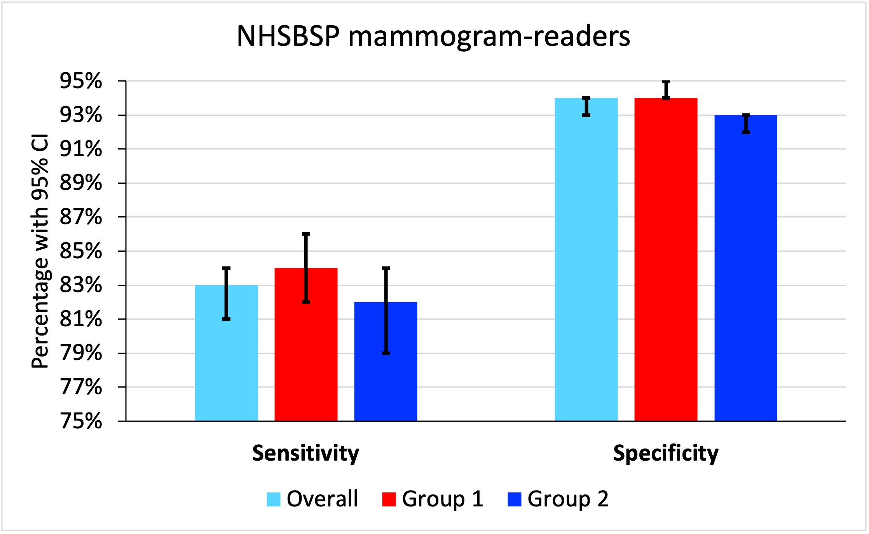
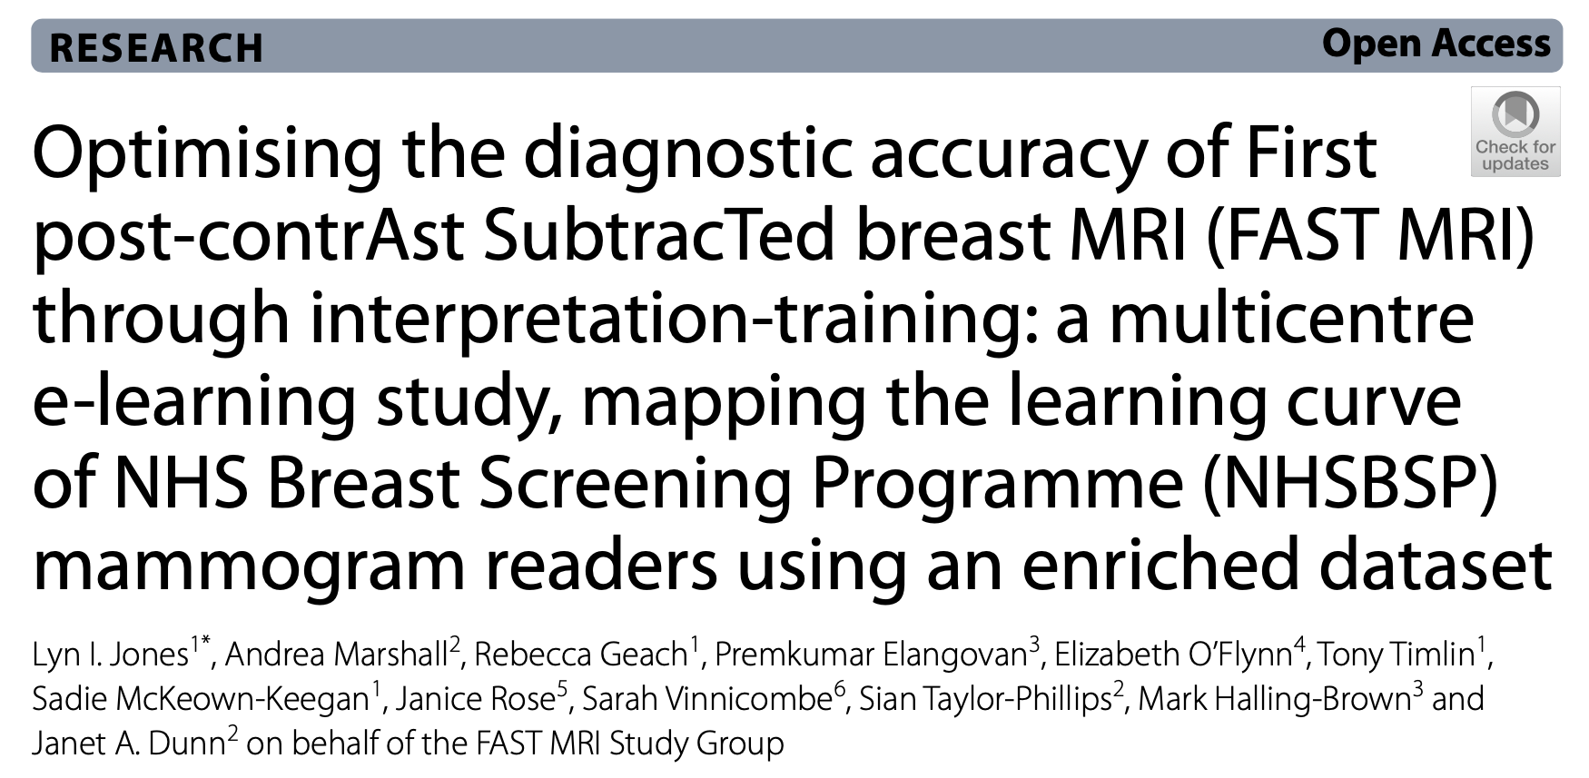
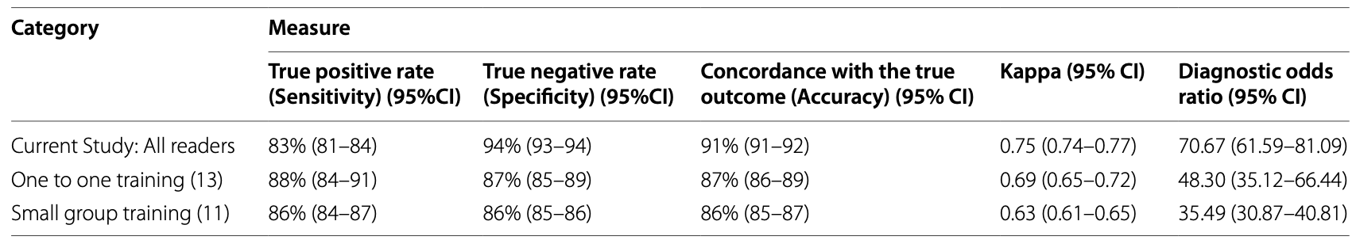
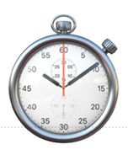
Breast Cancer Research 2024
The median time taken for readers to interpret each FAST MRI scan was 56 seconds for Group 1 (range 8-47466) and 78 seconds for Group 2 (14-22830 seconds) (p <0.0001)
Notes:
In our most recent update of this interpretation-training work, funded by Health Education England through a bursary from the National Breast Imaging Academy, we improved reader diagnostic accuracy and further narrowed the performance gap between novice and experienced breast MRI readers, but crucially also improved specificity, so that mammogram readers, when reading FAST MRI, can achieve benchmarks set for radiologists reading full protocol MRI after just 2 days of standardised interpretation-training. This work has formed the foundation of the credentialling process that we have used to certificate FAST MRI Readers for the DYAMOND study.

Slide 18
FAST MRI: DYAMOND
Funding reference: NIHR150502
B
1000 screening clients
Age 50-52, “B” density and “clear” screening mammograms
Setting: NHS Breast Screening Services:
  Avon
  Gloucestershire
  Cornwall
  Wiltshire
  South-West London
  South-East London
42 months grant start: 1st May 2023
REC: 23/YH/0268 CPMS: 59828 ISRCTN74193022
Notes:
So that was all about Why… but I must also tell you What we are doing in DYAMOND. We wish to recruit 1000 women with normal/benign, or in other words “clear” first screening mammograms, from NHS Breast Screening Service Sites across England. We have 42 months of funding and the grant was activated in May last year.

Slide 19
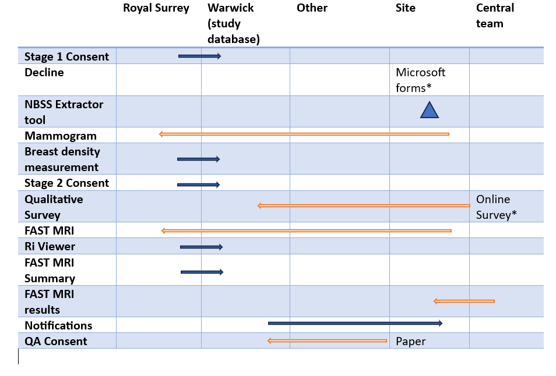
Data management
Notes:
We have our main database at Warwick Clinical Trials Unit and our image database at Royal Surrey.
We have striven to automate processes as much as possible and to maximize opportunities for recruitment across our study population. A big factor in the study design is the decision to ensure the FAST MRIs are reported entirely independently of the screening mammograms, and this has been facilitated by our collaboration with the Computer Scientists of the Royal Surrey. But you can see from this slide that the processes we have been setting up are quite complex. So how have we been getting on?

Slide 20
Grant activated
May 2023
Mar 2025
Notes:
Well, the grant was activated in May 2023 and we nearly 24 months in. But like any research study there are milestones that need to be reached. What follows is a snapshot of those we have achieved so far.

Slide 21
Grant activated
HRA and Ethics approval
NHSBSP RIDAC approval
BUST Charity Scanner installed
May 2023
Oct 2023
Jan 2024
Mar 2025
NBSS trial flag not possible
Create software alternative to flag
Need to upgrade RiViewer software
Update all reader training material
Notes:
Six months in we gained approval from the Breast Screening Programme’s Research Innovation and Development Advisory Committee for the study. Unfortunately, we also discovered that we would be unable to use a specific DYAMOND trial flag on the NBSS software, and this, along with other unrelated software needs, has complicated our study processes further. But in January (click) we obtained Ethics and Health Research Authority approval, and a new MRI scanner, bought for North Bristol by our local breast cancer charity, BUST (click) was installed in time to support scanner capacity for DYAMOND.

Slide 22
Grant activated
HRA and Ethics approval
Local IRMER approval
Local CC&C
NHSBSP RIDAC approval
Local Information Governance approval
BUST Charity Scanner installed
First QA scan
May 2023
Oct 2023
Jan 2024
Apr 2024
Nov 2024
NBSS trial flag not possible
Create software alternative to flag
Need to upgrade RiViewer software
Update all reader training material
Notes:
Spring was good to us and more approvals followed and in April (Click) we scanned our first two Quality Assurance participants on the new MRI scanner.

Slide 23
Grant activated
HRA and Ethics approval
Local IRMER approval
Local CC&C
NHSBSP RIDAC approval
Local Information Governance approval
BUST Charity Scanner installed
First QA scan
May 2023
Oct 2023
Jan 2024
Apr 2024
Mar 2025
Artefact on FAST images
NBSS trial flag not possible
Investigation into artefact
Create software alternative to flag
Need to upgrade RiViewer software
Update all reader training material
Notes:
Unfortunately, we noticed what looked like motion artefact on the QA scans. We halted the QA scanning process and instigated an investigation into the artefact.

Slide 24
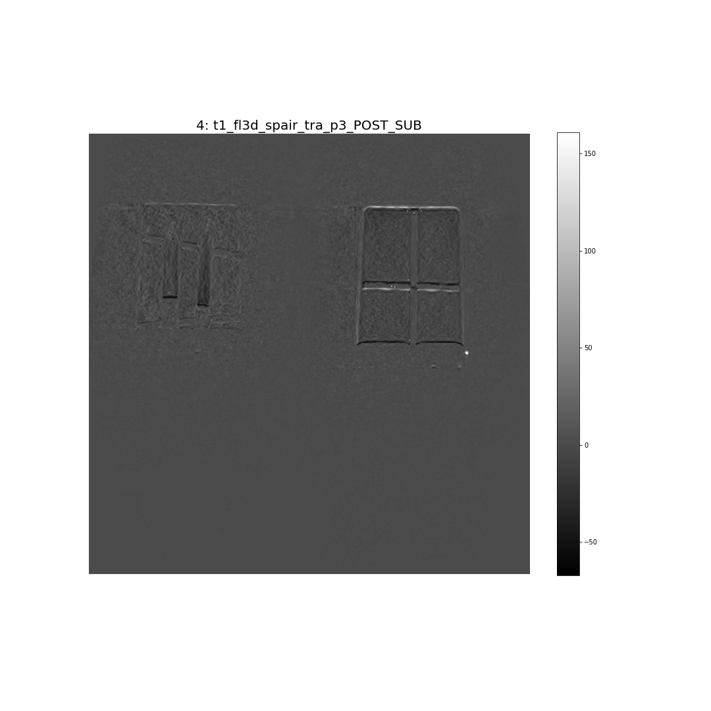

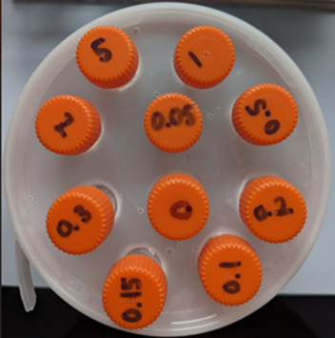
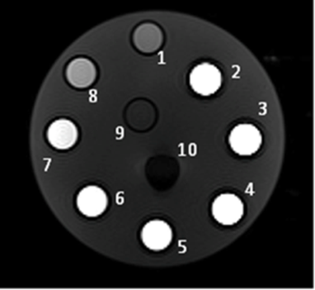
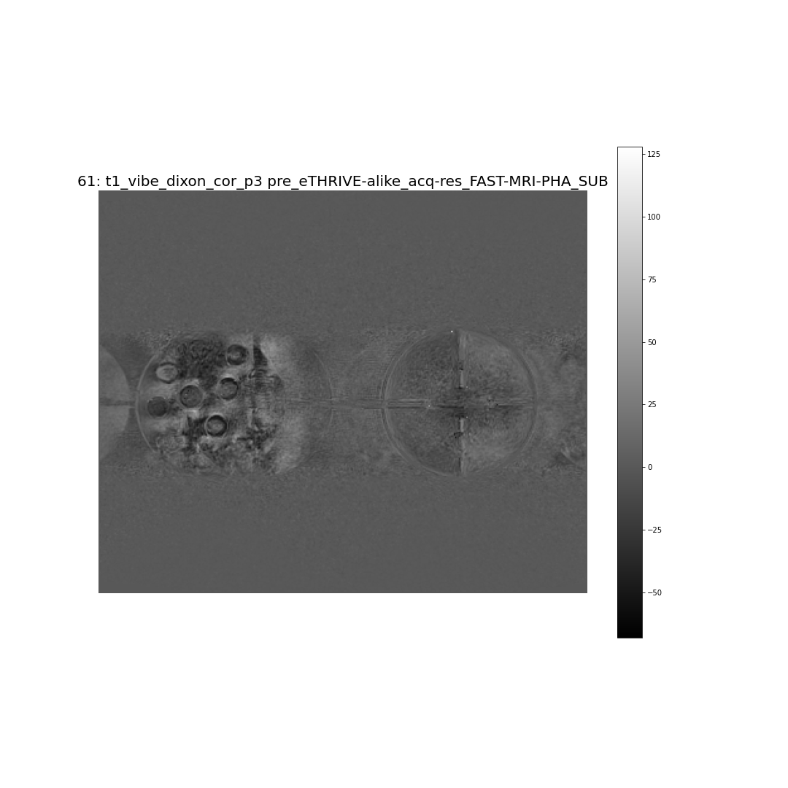
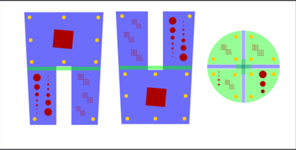

(RfPB) PB-PG-1217-20008
Notes:
Luckily, with an underspend from our previous NIHR grant, we had chosen to commission the Medical Physicists of our sister Bristol Trust to design some breast phantoms that will measure spatial resolution and dynamic contrast within DYAMOND. The Physicists scanned the phantoms on the new scanner and proved that the artefact was not due to patient movement. Fortunately, only the subtraction sequence is affected so it is only the DYAMOND study that cannot continue on the new scanner.

Slide 25
Grant activated
HRA and Ethics approval
Local IRMER approval
Local CC&C
NHSBSP RIDAC approval
Local Information Governance approval
Associate PI Scheme
BUST Charity Scanner installed
First QA scan
May 2023
Oct 2023
Jan 2024
Apr 2024
June 2024
Mar 2025
Artefact on FAST images
NBSS trial flag not possible
Investigation into artefact
MRI capacity issues
Create software alternative to flag
NHSBSP capacity issues
Need to upgrade RiViewer software
Update all reader training material
Notes:
The artefact is still under investigation by the scanner manufacturers, but our MRI Department has kindly said we may use the other 3T scanner for DYAMOND and we have now successfully completed the scanning of our quality assurance participants on this other scanner. Nevertheless, there are still MR capacity issues… and, as every summer brings, Breast Screening Service capacity issues too.

Slide 26
Grant activated
HRA and Ethics approval
Local IRMER approval
Local CC&C
Database development complete
Recruitment start
NHSBSP RIDAC approval
Local Information Governance approval
Associate PI Scheme
Trial flag work-around & assessment clinic booking method agreed
BUST Charity Scanner installed
First DYAMOND Readers certificated
First QA scan
May 2023
Oct 2023
Jan 2024
Apr 2024
June 2024
Apr 2025
Artefact on FAST images
NBSS trial flag not possible
Investigation into artefact
MRI capacity issues
Create software alternative to flag
NHSBSP capacity issues
Need to upgrade RiViewer software
Update all reader training material
Notes:
Thankfully, this Autumn we have achieved some more significant milestones (Click), including that the first few of our Readers, who had credentialled during one of our previous interpretation-training studies, have completed their refresher training and become certified as fully fledged DYAMOND Readers. Although delayed, I am now confident we should get the greenlight for the study (Click) in time to start recruitment in the third week of November.

Slide 27


Slide 28







THANK YOU
Notes:
This last slide acknowledges the organisations who have contributed to the FAST MRI programme, including our public and patient representative organisations. Thank you.

